Slide 1
Food Sales Prediction Model
Using Intel(R) Extension for Scikit-learn
-a project by Sayan Malakar Co- Founder @Trythemenu

Slide 2


How can a restaurant or a cafe owner will know if their food item has a probability of getting max sales?
So, by using this prediction model they can easily predict if their food item will have a high number of sales or not. This model is built on python using different libraries:
Pandas library
Scikit Learn Library
Streamlit Library
Plotly Library
Intel(R) Extension for Scikit-learn library
This is a prototype ML model to be used in (https://trythemenu.com) and currently running on a synthetic dataset

Slide 3
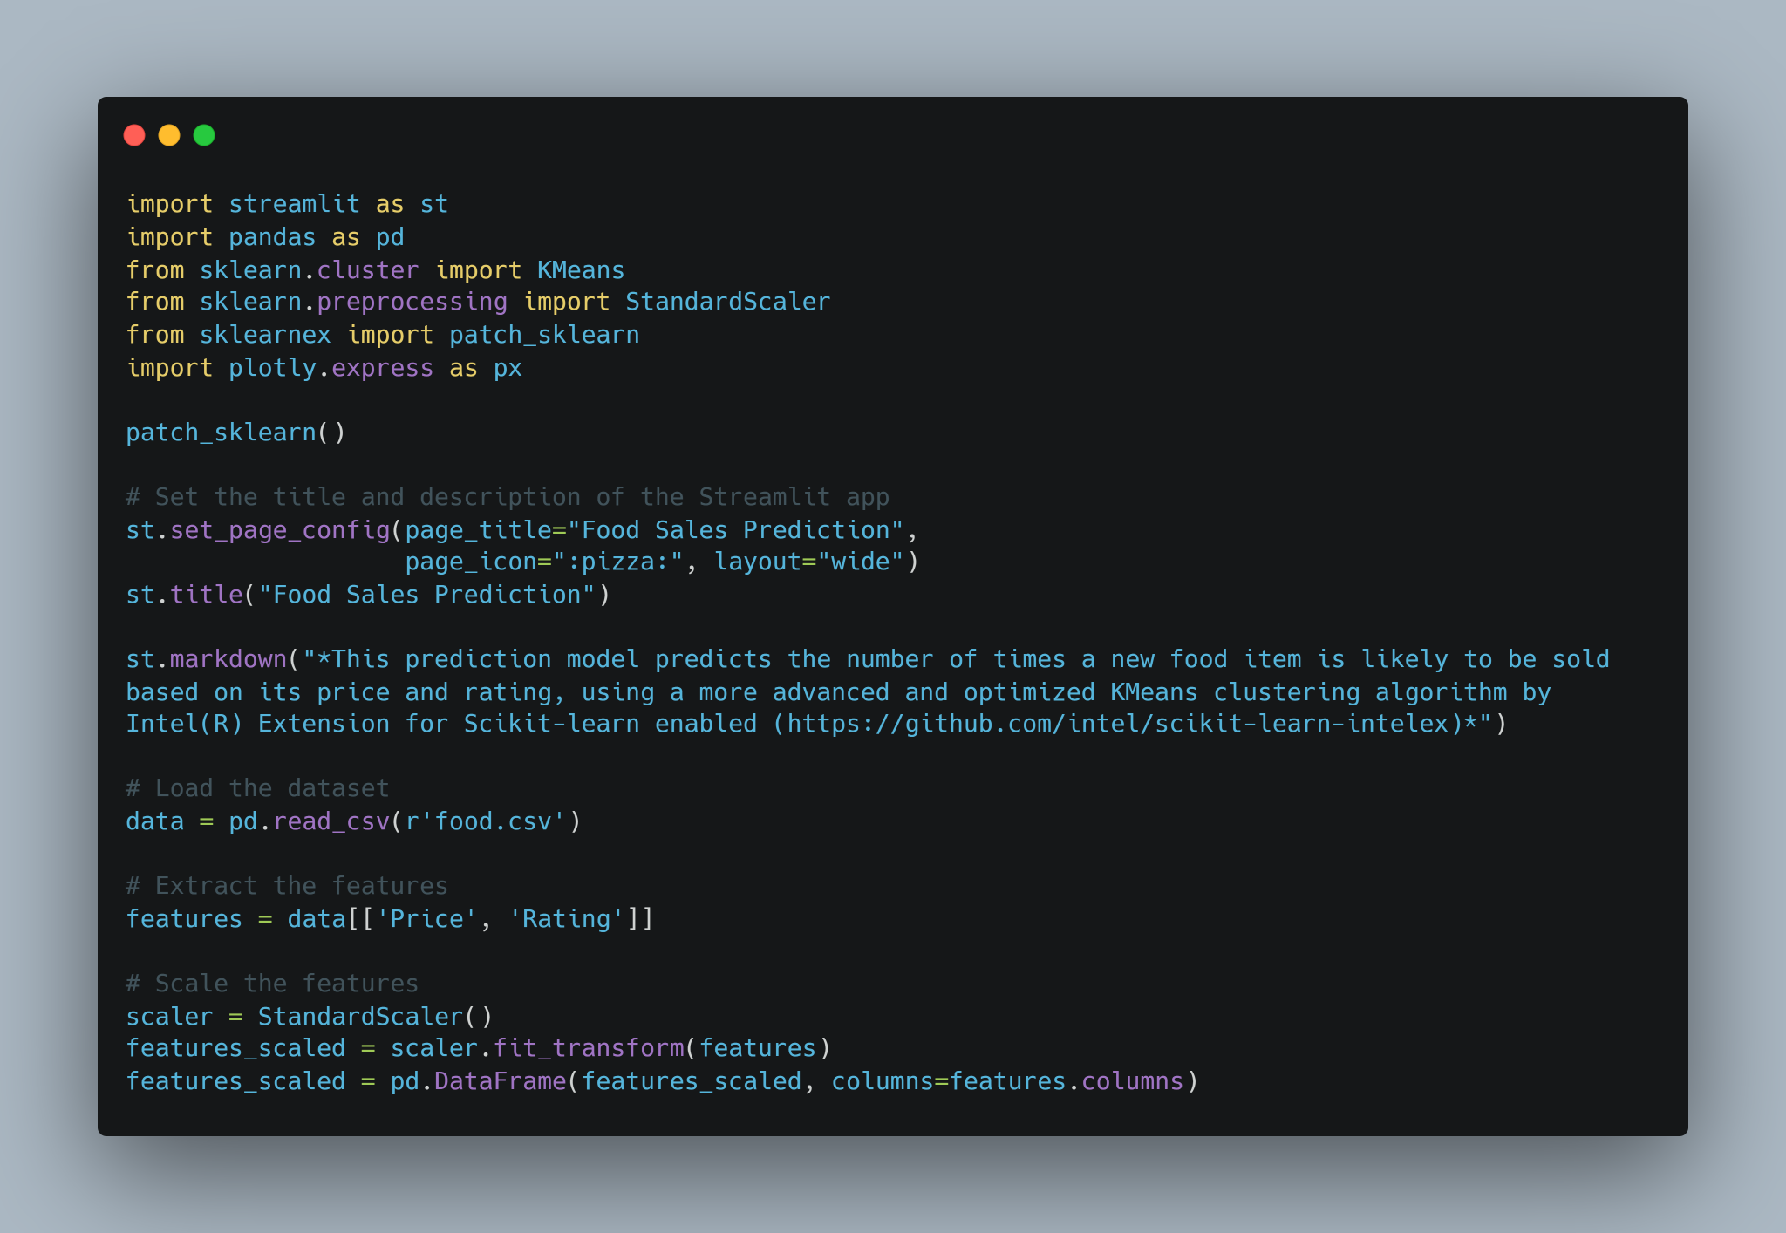
Code Preview

Slide 4
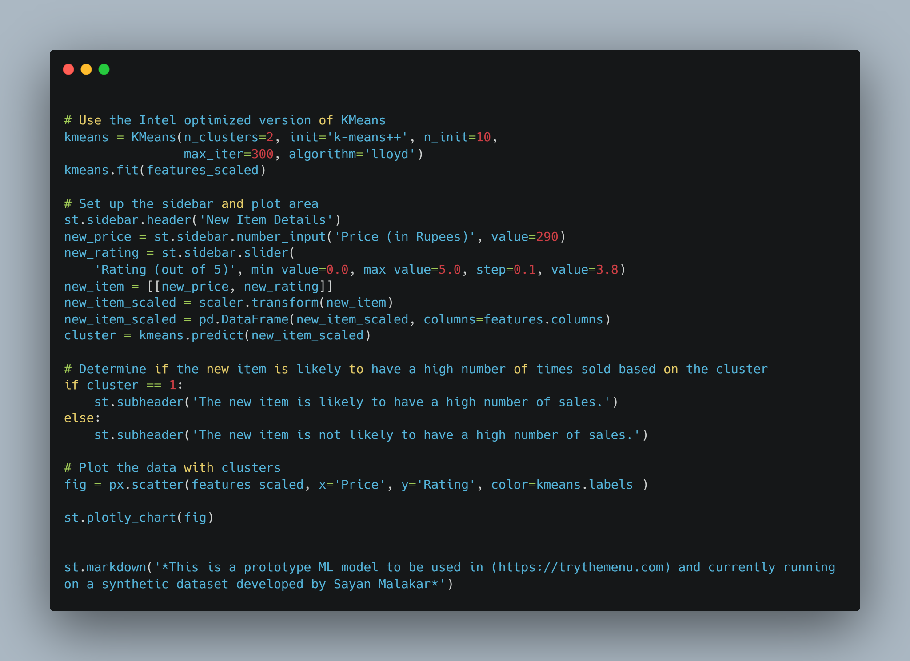
Code Preview

Slide 5
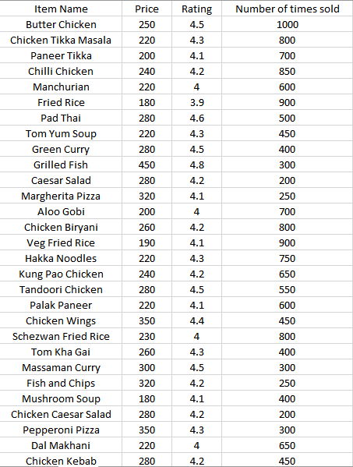
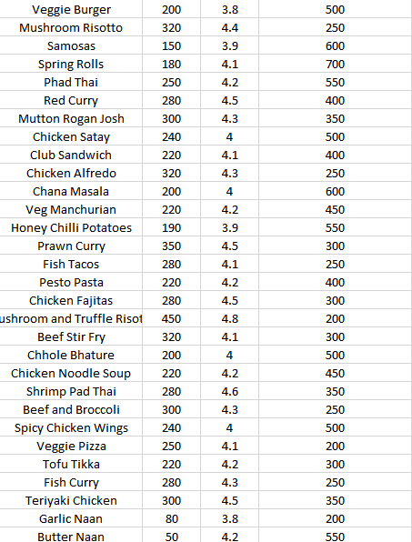
Synthetic Dataset

Slide 6
Setting up the Model
To get started with the model we need Conda terminal and the code file with the required dataset.
The Conda terminal and the code files with dataset must be in the same directory.
You can find the model here: https://github.com/sayan681/ttm_sale_prediction
In Conda terminal we just have to write the command to start the prediction model:
- streamlit run Prediction_rating.py

Slide 7
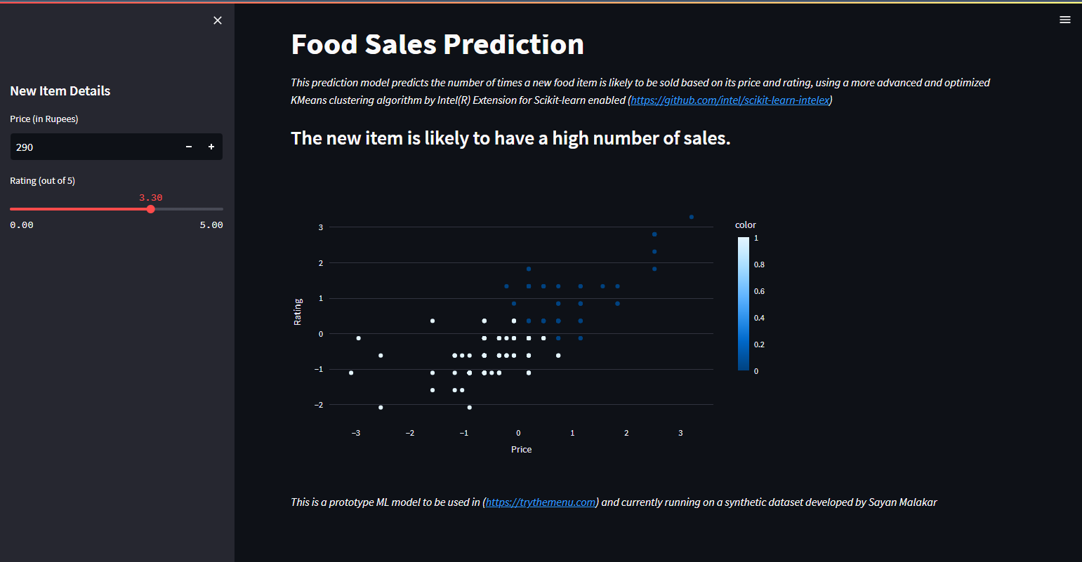
Project Preview

Slide 8
Conclusion
This was just a prototype model which can be used to predict high sale value of any item. By using Intel(R) Extension for Scikit-learn module the prediction model is much improved but also we can improve the model by using more useful feature selection and huge dataset, as this model was built on a synthetic dataset. We will be implementing this model on our current start-up @TryTheMenu and scale this up to make it available to more of our customer base

Slide 9
Thank You

